Slide 1









Introduction to Regression Models
Wildlife Tourism College
Pardamat Conservation Area
16 – 20 September 2024
Award: 80NSSC23K1537

Slide 2
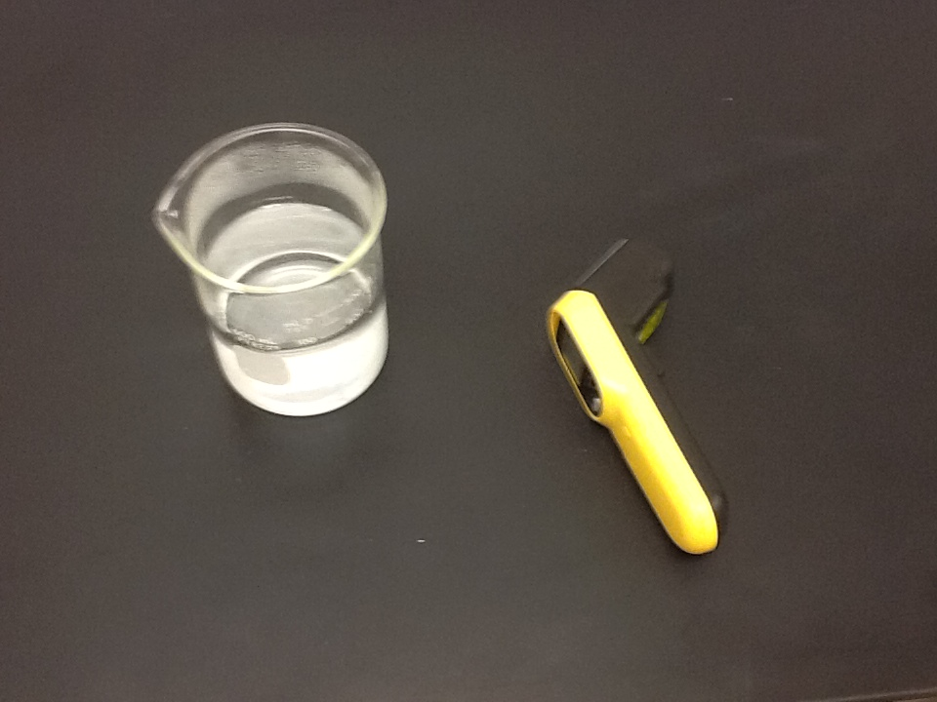
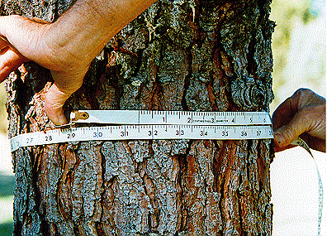
“Physics” data
Ecology data
Annual growth (cm)
Diameter (cm)

Slide 3
Strong relationships
Weak relationships
No relationship
Y
Y
Y
X
X
X
Y
Y
Y
X
X
X
Slide from: Statistics for Managers Using Microsoft® Excel 4th Edition, 2004 Prentice-Hall

Slide 4
Scatter Plots of Data with Various Correlation Coefficients
Y
Y
Y
X
X
X
r = -1
r = -.6
r = 0
Y
Y
Y
X
X
X
r = +1
r = +.3
r = 0
Slide from: Statistics for Managers Using Microsoft® Excel 4th Edition, 2004 Prentice-Hall
Slide from: Statistics for Managers Using Microsoft® Excel 4th Edition, 2004 Prentice-Hall

Slide 5
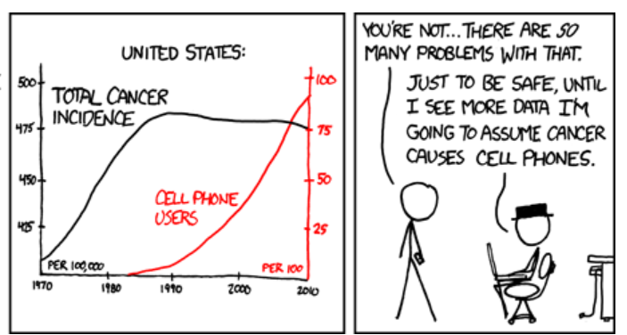
Correlation
Measures the strength of association between two variables
Ranges between –1 and 1
The closer to –1, the stronger the negative association
The closer to 1, the stronger the positive association
The closer to 0, the weaker the association

Slide 6
Linear regression
In regression, one variable is called the “independent variable” (or “predictor variable”) and the other is called the “dependent variable” (or “response variable”).
You may have seen this:
Y = mX + B
m
Dependent Variable
Independent Variable
B

Slide 7
Prediction
If you know something about X, this knowledge helps you predict something about Y.
Y = mX + B
m
B

Slide 8
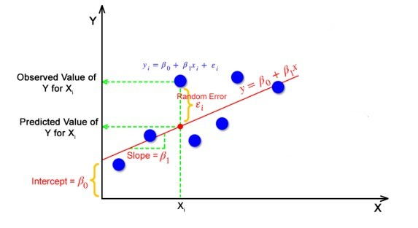
Prediction
If you know something about X, this knowledge helps you predict something about Y.
Y = mX + B
Y = β₀ + β₁X + ε
Fixed – exactly on the line
Residuals – deviations from the line

Slide 9
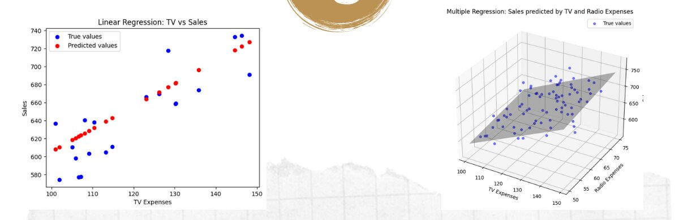
Multiple Linear Regression
Using two or more independent variables to predict the outcome of a dependent variable
“Simple Linear Regression”
“Multiple Linear Regression”
Y = β₀ + β₁X + ε
Y = β₀ + β₁X₁ + β₂X₂ + ε

Slide 10
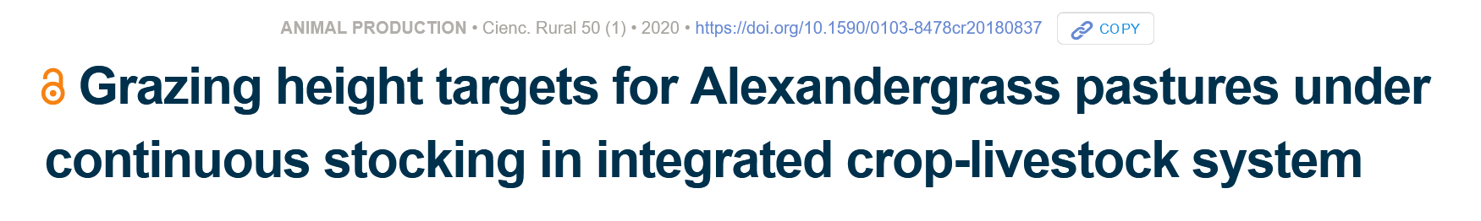
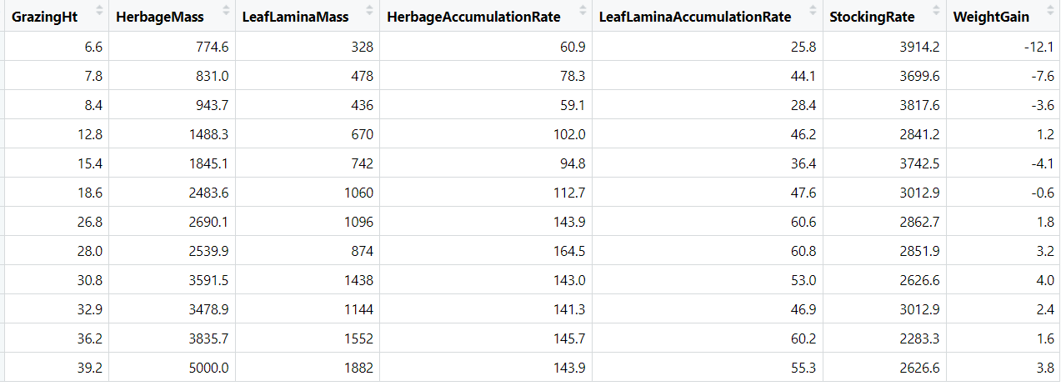
cm
KgDM/ha
KgDM/ha
KgDM/ha/day
KgDM/ha/day
KgLW/ha
KgLW/ha/day

Slide 11
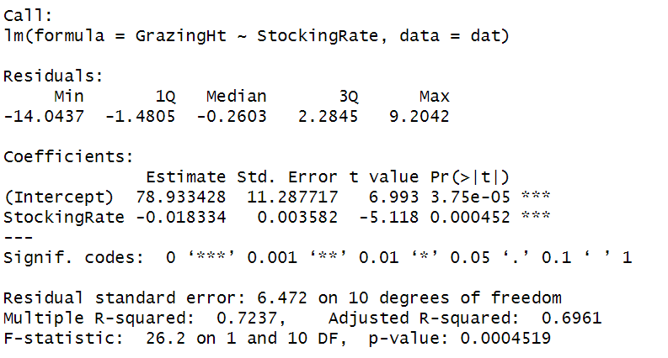

Linear Regression in R
β₀
β₁

Slide 12
Prediction
If you know something about X, this knowledge helps you predict something about Y.
Y = mX + B
Y = β₀ + β₁X + ε
Fixed – exactly on the line
Residuals – deviations from the line

Slide 13
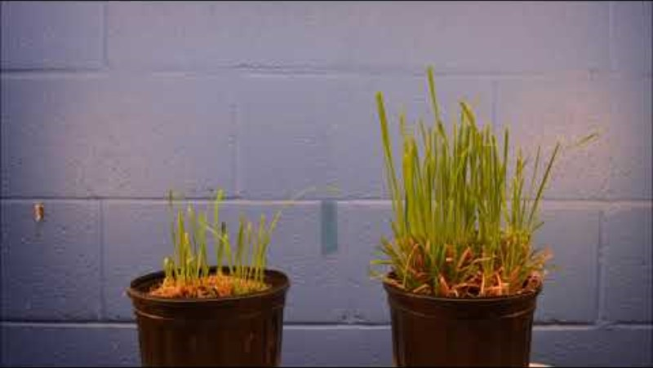

Slide 15
Assumptions
Linear regression assumes that…
The residuals are normally distributed
The variances of the residuals are homogenous (homoscedasticity)
The observations are independent (no serial auto-correlation
Not biased by unduly influential observations

Slide 16
Residual Analysis for Homoscedasticity
Y
Y
x
x
residuals
x
x
residuals
✓
Non-constant variance
Constant variance
Slide from: Statistics for Managers Using Microsoft® Excel 4th Edition, 2004 Prentice-Hall

Slide 17
Residual Analysis for Independence
Not Independent
✓
Independent
residuals
X
residuals
X
residuals
X
Slide from: Statistics for Managers Using Microsoft® Excel 4th Edition, 2004 Prentice-Hall

Slide 18
Regression approaches of increasing complexity
Approach | Response Variable | Predictor Variables | Random Effects? | Error distribution (“noise”) | R function
Simple Linear Regression | Continuous | Continuous | No | Normal | lm, glm
ANOVA | Continuous | Discrete | No | Normal | aov, lm, glm
Generalized Linear Models | Continuous, Count, Proportions, Binary (0/1) | Continuous and/or Discrete | No | Normal, Poisson, Binomial, Gamma, etc… | glm
Generalized Linear Mixed Models | Continuous, Count, Proportions, Binary (0/1) | Continuous and/or Discrete | Yes | Normal, Poisson, Binomial, Gamma, etc… | lmer, glmer

